Slide 2
From Legacy to Leading Edge
Modernizing Data with Fabric
Russ Seaman
Solution Architect II | TD Synnex

Slide 3
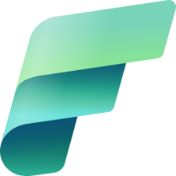
What is Fabric?
And more importantly, why would we want to use it?

Slide 4


The starting line
Several
1
Data copies and infrastructure inefficiencies
Business team
Business team
Business team
Tech team
Tech team
Limited interoperability between vendor services
2
Vendor 4: Compute and serving
Vendor 4: Compute and serving
Vendor 3: Data management
Vendor 3: Data management
Vendor 2: Storage
Vendor 2: Storage
Vendor 1: Ingestion
Vendor 1: Ingestion
3
Data exposure risks
Enterprise data sources

Slide 5
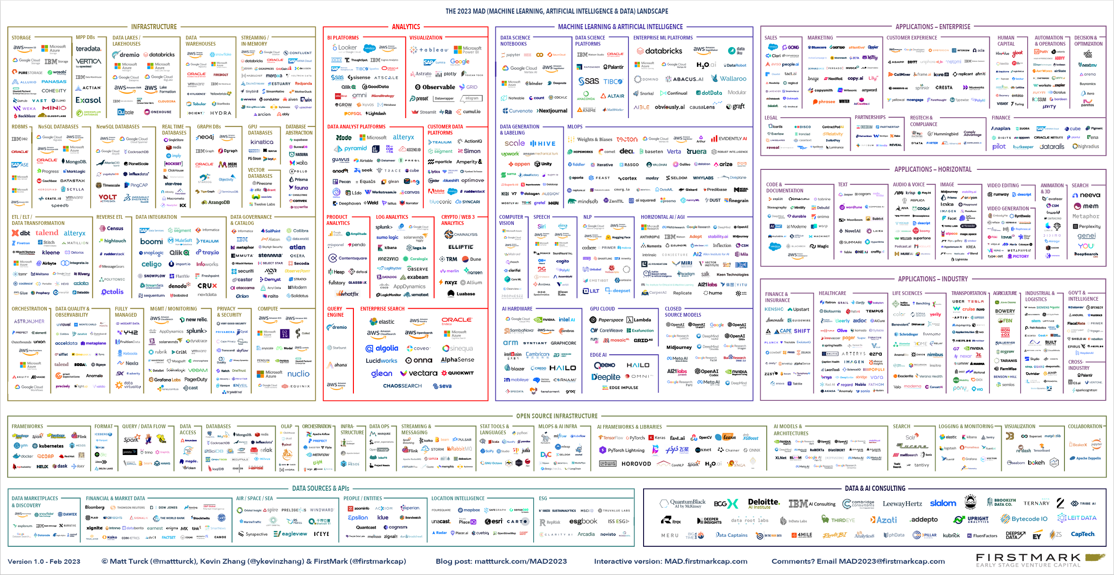

Slide 6

(
From
To
Multiple analytics services
Unified stack
Disconnected data sources
All the data in one place
Isolated application
Entire estate
Gen AI bolt on
Gen AI built in

Slide 7

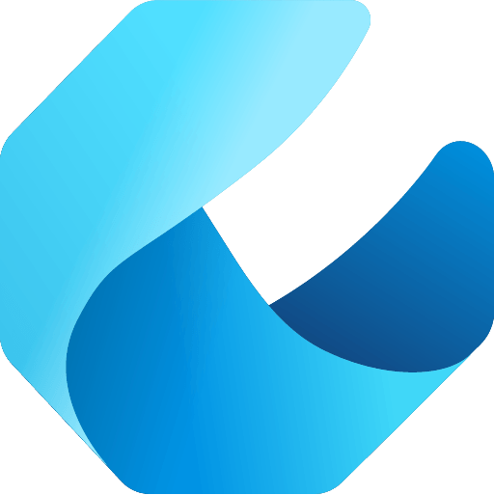
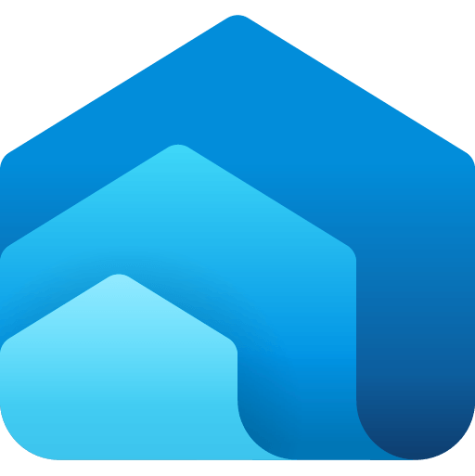
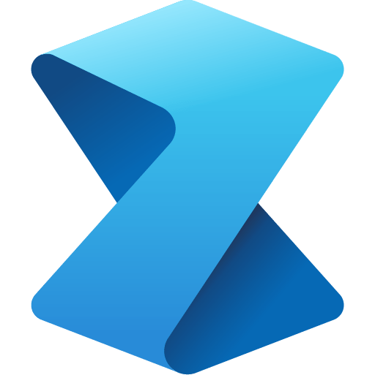


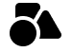
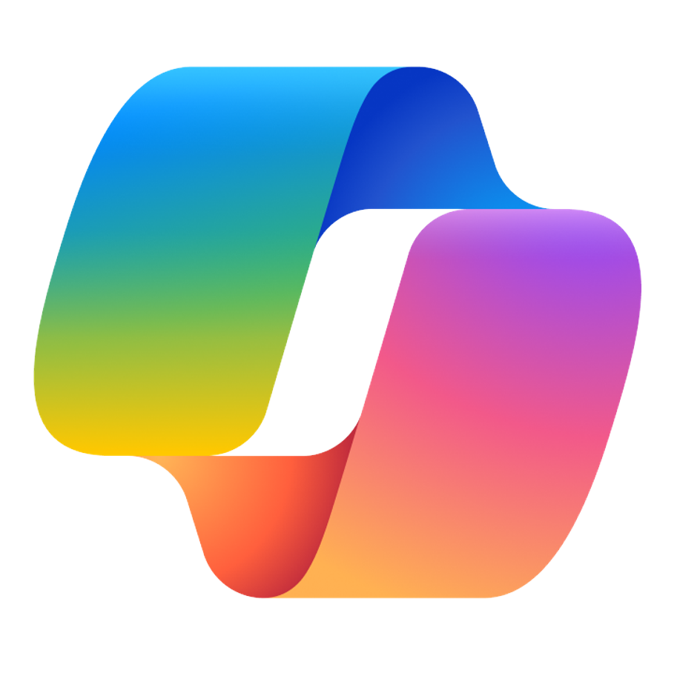

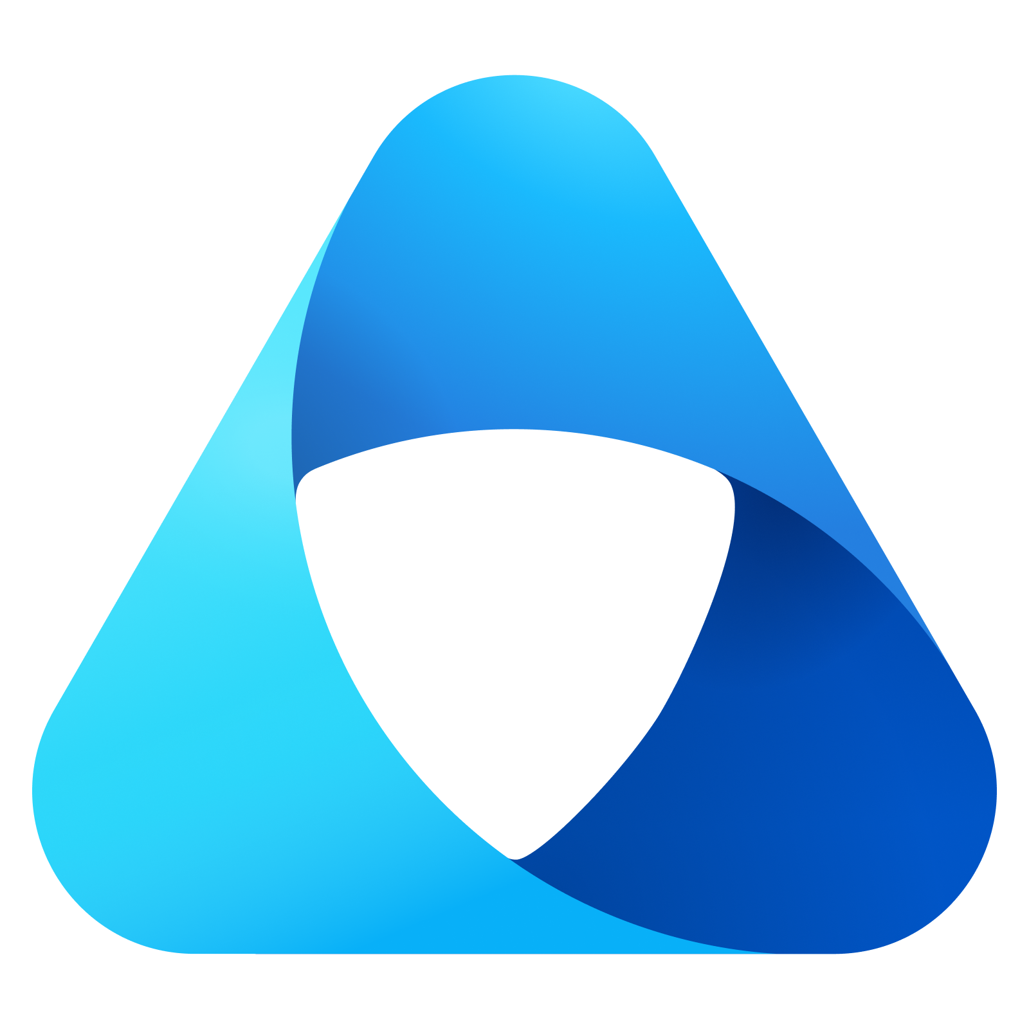
Microsoft Fabric
Partner & Industry workloads
Data Factory
Data Engineering
Data Warehouse
Data Science
Real-Time Intelligence
Power BI
Copilot in Fabric
OneLake
Microsoft Purview

Slide 8
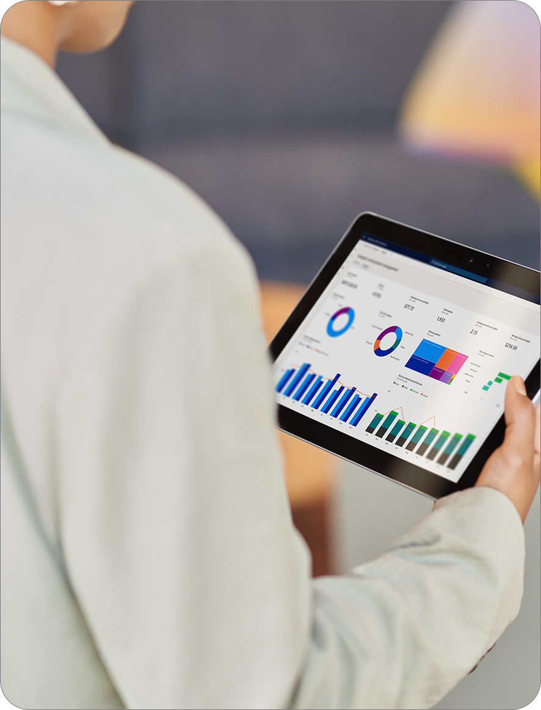
Establish a trusted data foundation
Connect to any data from a single, multi-cloud data lake and use a single copy of data across engines
Unify your analytics on a complete, governed platform
Reduce the cost and effort of integration with a unified, secure, and governed platform
Empower every business user
Empower everyone to uncover insights accessible data, easy-to-use tools, and visuals embedded apps they use everyday
Fuel your AI innovation
Adopt a data platform infused with AI at every layer to help you get more done, faster

Slide 9

OneLake to rule all your data.
It’s like “OneDrive”, just for your data.

Slide 10






OneLake for all your data
A single SaaS lake for the whole organization
Provisioned automatically with the tenant
All workloads automatically store their data in the OneLake workspace folders
All the data is organized in an intuitive hierarchical namespace
The data in OneLake is automatically indexed for discovery, MIP labels, lineage, PII scans, sharing, governance and compliance
Data
Factory
Data
Engineering
Data
Science
Data Warehouse
Real Time Analytics
Partner & Industry workloads
Power BI
OneLake
Intelligent data foundation

Slide 11
A single unified SaaS data lake
Provisioned automatically with the tenant.
Data
Factory
Data
Engineering
Data
Science
Data Warehouse
Real-Time Intelligence
Power BI
Any data in OneLake works with out-of-the-box governance such as data lineage, data protection, certification, catalog integration, etc. All data is ultimately under the control of a tenant admin.
OneLake
OneLake enables distributed ownership. Different workspaces allow different parts of the organization to work independently while still contributing to the same data lake. Each workspace can have its own administrator, access control, region and capacity for billing.
Workspace
POS sales
Workspace online sales
Workspace
customer
Workspace
ads
Workspace
expenses
Unified Security and Governance

Slide 12
OneLake for all domains OneLake give a true data mesh as a service
Sales
Marketing
Finance
Introducing domains as an integral part of Fabric: A domain is a way to logically group together all the data in an organization relevant to an area or field, according to business needs.
Data
Factory
Data
Engineering
Data
Science
Data Warehouse
Real-Time Intelligence
Power BI
Domains are defined with domain admins and contributors who can associate workspaces and group them together under a relevant domain.
Federated governance can be achieved by delegating settings to domain admins, thus allowing them to achieve more granular control over their business area.
OneLake
Domains simplify discovery and consumption of data across the organization, thus allowing business optimized consumption.
Workspace
POS sales
Workspace online sales
Workspace
customer
Workspace
ads
Workspace
expenses
Sales
Marketing
Finance
Avoid data swamps by endorsing certain data as certified or promoted, thus encouraging reuse.
Unified Security and Governance

Slide 13
To achieve data residency requirements, workspaces can reside in different regions around the world while still being part of the same data lake.
OneLake
Workspace
POS sales
Workspace online sales
Workspace
customer
Workspace
ads
Workspace
expenses
Data can reside in different regions without the overhead of managing different storage resources and without creating data silos.
OneLake provisions storage resources for each workspace to meet demand for scale (capacity, throughput and IOPS).
Underlying physical storage is virtualized away.
All storage is zone redundant by default with an option for Geo redundancy.

Slide 14
One Copy for all computes One copy of data can be read by all engines
Once data is stored in the lake, it is directly accessible by all the engines without needing any import/export.
You are able to choose the right engine for the right job.
All the compute engines have been fully optimized to work with Delta Parquet as their native format.
Shared universal security model is enforced across all the engines (coming soon).
Data
Factory
Data
Engineering
Data
Science
Data Warehouse
Real-Time Intelligence
Power BI
Spark
T-SQL
Serverless
Compute
KQL
Analysis Services
Customers 360
OneLake
Delta – Parquet Format

Slide 15


Open Access to data in OneLake No lock-in with industry standard APIs and open file formats
By supporting the ADLS Gen2 DFS APIs and SDKs, OneLake is compatible with existing ADLS applications.
Tenants will appear as one big storage account with different workspaces appearing as different containers with data organized into folders.
Underlying physical storage is virtualized away. OneLake ensures proper scale and performance.
Data
Factory
Data
Engineering
Data
Science
Data Warehouse
Real-Time Intelligence
Power BI
Spark
T-SQL
Serverless
Compute
KQL
Analysis Services
Customers 360
OneLake
Delta – Parquet Format
Other ADLS
compatible
applications
Azure Databricks
Azure HDI

Slide 16
Data Factory

Slide 17
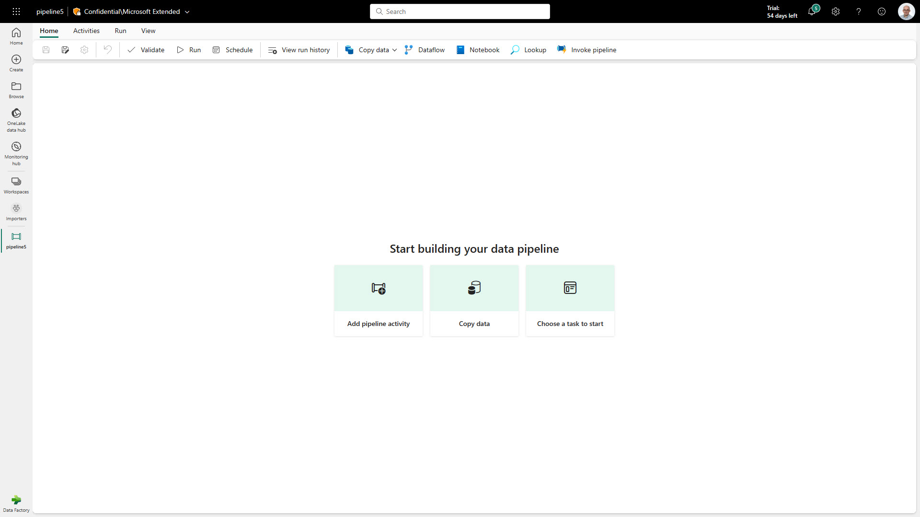
Data Factory
Data Factory in Microsoft Fabric provides cloud-scale data movement and data transformation services that allows you to solve the most complex ETL scenarios
Core to Data Factory are Data Pipelines and Dataflows to give users the option to a low-code, collaborative and enterprise scale approach for their ETL process
Key Capabilities:
Latest capabilities:
Output destination to Lakehouse
170+ connectors available in Data Factory
Pipeline Lakehouse copy assist
Create data pipeline in Lakehouse portal
Pipeline templates
Pipeline support for Spark notebooks
Service principle auth support
Autonomous ETL can unlock operational efficiencies and help orchestrate, monitor and manage pipeline performance.
Notes:
Microsoft Fabric's Data Factory offers a modern data integration platform enabling robust data ingestion, preparation, and transformation from a variety of sources to support analytics within Lakehouse and Data Warehouse environments. It's designed for both citizen developers and professionals, offering over 300 transformations for efficient data manipulation​​.
Dataflows within Data Factory provide a low-code interface that leverages Power Query, allowing users to perform complex data transformations with ease. This includes joining, aggregation, and data cleansing, which can be loaded into multiple destinations and refreshed manually or on a schedule​​.
Data pipelines in Data Factory support large-scale, complex workflows and offer rich orchestration capabilities. This includes moving petabyte-size data and sophisticated control flow with loops and conditionals, enabling the creation of comprehensive ETL workflows that integrate various tasks including code-first activities like Spark Notebooks and SQL scripts​

Slide 18
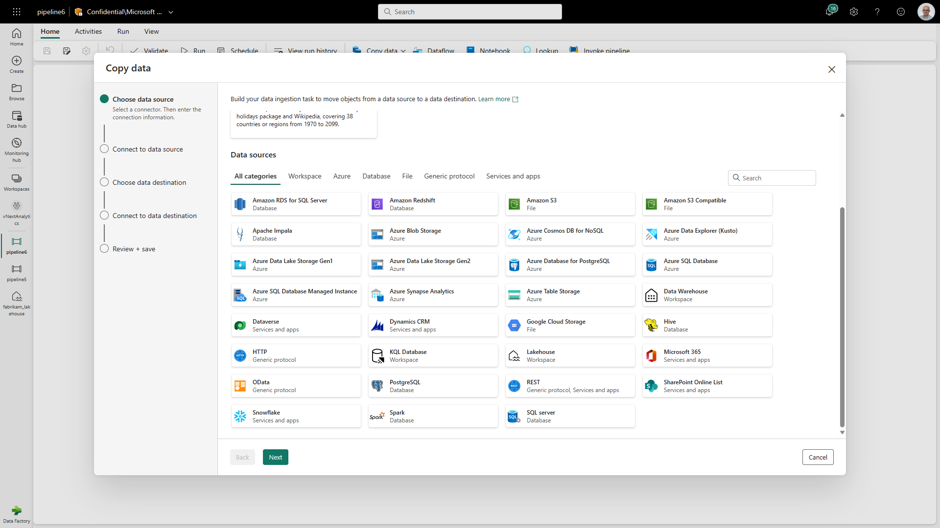
Data Pipelines
Data Pipelines enable powerful workflow capabilities at cloud-scale like building complex workflows, moving PB-size data, and defining sophisticated control flow pipelines
Data pipelines can be used to build complex ETL and data factory workflows that can perform a number of different tasks at scale. Additionally, control flow capabilities are built into pipelines so you can build workflow logic which provide loops and conditional
Notes:
Data pipelines in Microsoft Fabric allow for the construction of complex ETL workflows that can orchestrate a wide variety of tasks at scale. These pipelines facilitate cloud-scale data movement and provide advanced workflow capabilities​​.
The control flow within data pipelines is sophisticated, offering logic constructs such as loops and conditionals to handle complex data manipulation scenarios efficiently and effectively​​.
Integration of code-first activities, such as Spark Notebooks and SQL scripts, with configuration-driven copy activities, enables end-to-end data pipeline creation for diverse data transformation requirements​

Slide 19
Data Pipelines | Connectors
New Connectors provide a low-code interface for ingesting data from a variety of data sources​
Connectors:
Warehouse Connector; connect to existing Azure
Lakehouse connector
100+ connectors in the copy activity
Access to on-premises data
Access protected data inside of a VNET
Notes:
New Connectors provide a low-code interface for ingesting data from a variety of data sources​
New Connectors:
Warehouse Connector; connect to existing Azure Synapse
Lakehouse connector
14 new connectors in the copy activity: Amazon S3, Azure Table, Amazon Redshift, OData, Google Cloud Storage, Apache Impala, Hive, SQL Server, Azure Synapse Analytics, HTTP, REST, PostgreSQL, Azure Database for PostgreSQL, and Azure Data Explorer

Slide 20
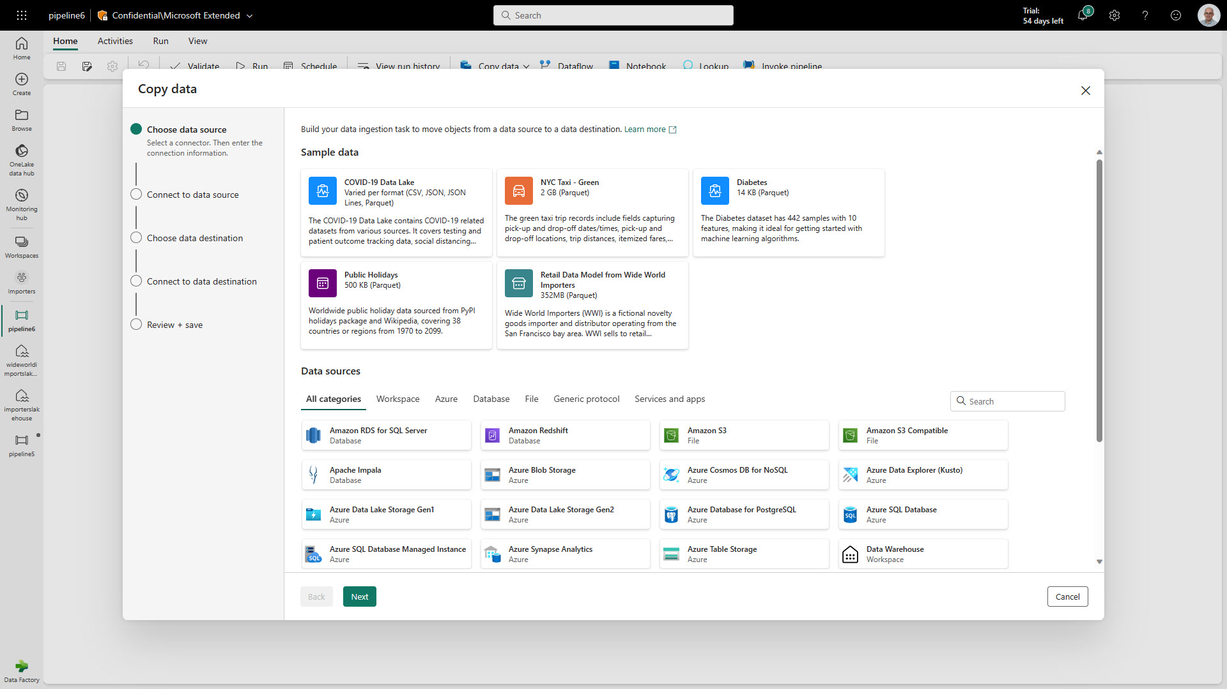
Data Pipelines | Sample data
Sample Datasets helps new users get started quickly, building out their ELT processes using Data Pipelines
Sample datasets:
COVID-19 Data Lake (CSV, JSON, JSON Lines, Parquet)
NYC Tax – Green (2GB Parquet)
Diabetes (14K Parquet)
Public Holidays (500KB Parquet)
Retail Data Model from Wide World Importers (352MB Parquet)
Notes:
Sample Datasets helps new users get started quickly, building out their ELT processes using Data Pipelines
Sample Semantic models:
COVID-19 Data Lake (CSV, JSON, JSON Lines, Parquet)
NYC Tax – Green (2GB Parquet)
Diabetes (14K Parquet)
Public Holidays (500KB Parquet)
Retail Data Model from Wide World Importers (352MB Parquet)

Slide 21
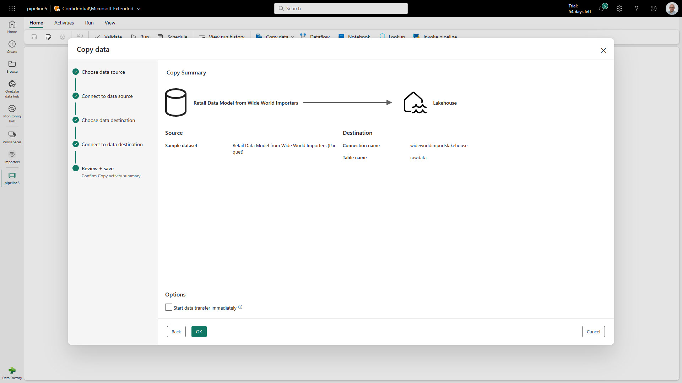
Data Pipelines | Lakehouse copy assist
Simply copying data to a Lakehouse with copy assist capabilities within the Data Pipeline
Additionally, users can create a Data Pipeline without having to leave the Lakehouse portal
Notes:
Simply copying data to a Lakehouse with copy assist capabilities withing the Data Pipeline
Additionally, user can create a Data Pipeline without having to leave the Lakehouse portal

Slide 22
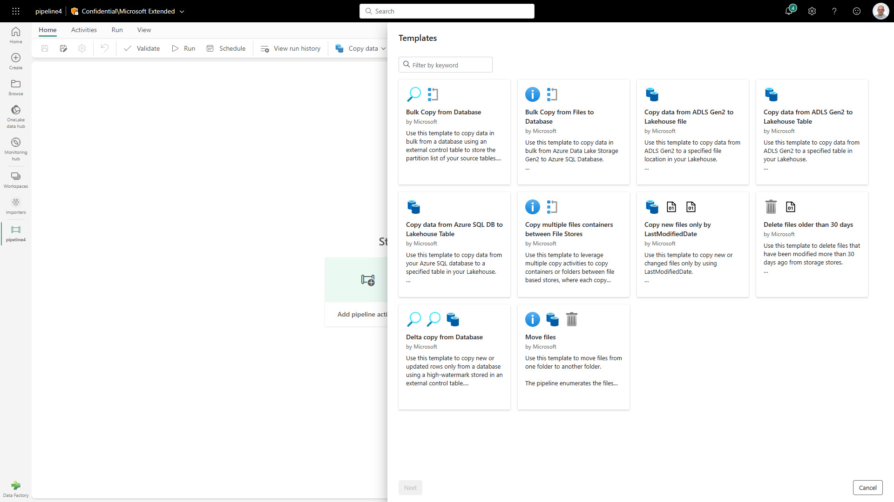
Data Pipelines | Templates
Quickly get started with data integration
Template help reduce development time by providing an easy way to create pipeline for common data integration scenarios
Available Data Pipeline Templates:
Bulk copy from Database
Bulk copy from File to Database
Copy data from ADLS Gen2 to Lakehouse file
Copy from ADLS Gen2 to Lakehouse Table
Copy data from Azure AQL DB to Lakehouse Table
Copy multiple files containers between File Stores
Copy new files only by Last Modified Date
Delete files older than 30 days
Delta copy from Database
Move files

Slide 23
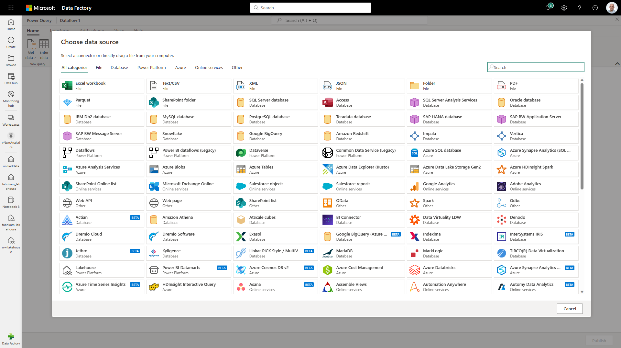
Dataflow
Dataflow provides a low-code interface for ingesting data from hundreds of data sources
Dataflow quickly and easily unify disparate data sources, establish a more collaborative analytics approach, and promote more informed, agile decision making.
Key Capabilities:
Accelerate data transformation with code-free data flows
Scale out using Fabric compute and Data Factory fast copy
Load results of data transformations into multiple destinations (Azure SQL Databases, Lakehouse, etc.)
Notes:
A dataflow is a collection of tables that are created and managed in workspaces in the Power BI service. A table is a set of columns that are used to store data, much like a table within a database. These tables are created as a result of Power Query transformations.
The new generation of dataflows resides alongside the Power BI Dataflow (Gen1) and brings new features and improved experiences.
Similar to Dataflow Gen1, Dataflow Gen2 allows you to transform your data into dataflow's internal/staging storage where it can be accessed using the Dataflow connector. Dataflow Gen2 also allows you to specify a data destination for your data. Using this feature, you can now separate your ETL logic and destination storage. This feature benefits you in many ways. For example, you can now use a dataflow to load data into a lakehouse and then use a notebook to analyze the data. Or you can use a dataflow to load data into an Azure SQL database and then use a data pipeline to load the data into a data warehouse.
In Dataflow Gen2, we added support for the following destinations and many more are coming soon:
Fabric Lakehouse
Azure Data Explorer (Kusto)
Azure Synapse Analytics (SQL DW)
Azure SQL Database

Slide 24
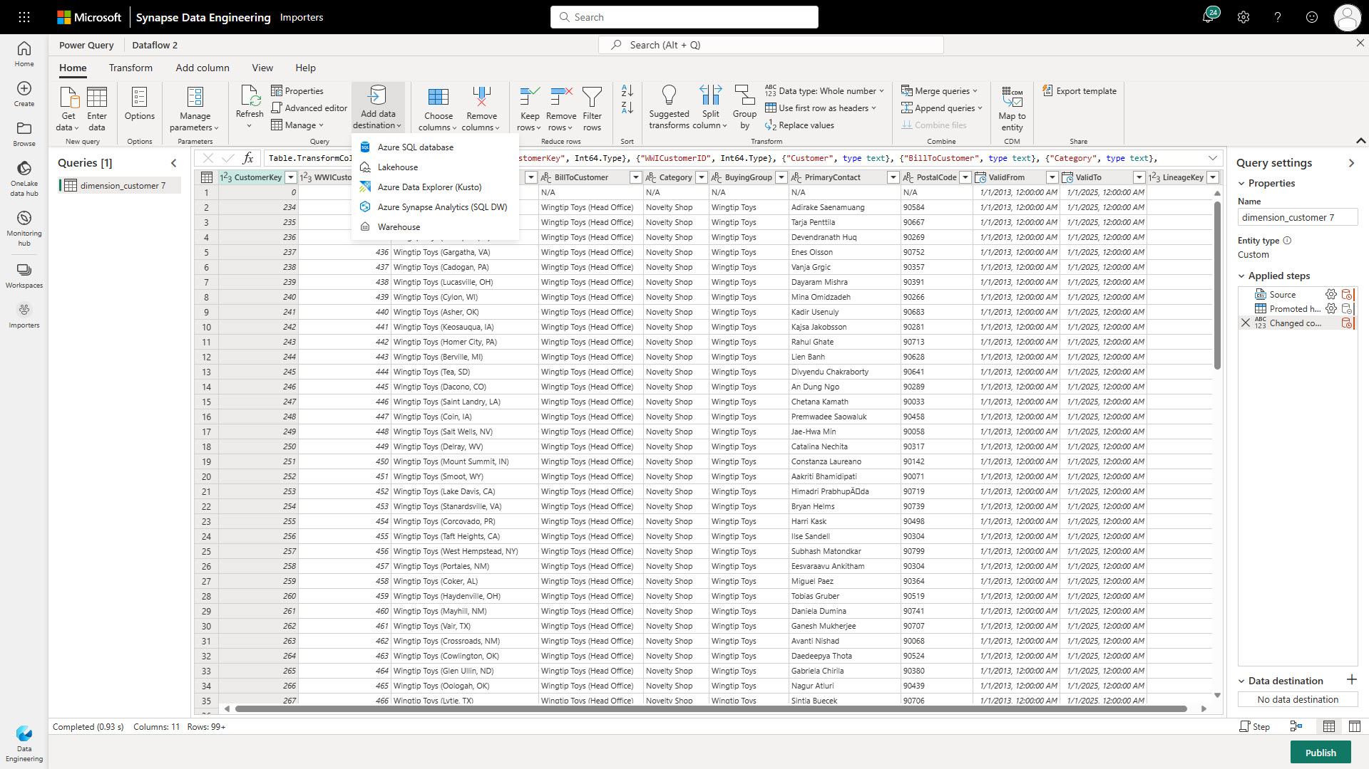
Dataflow | Output to Lakehouse
Simply write into a Lakehouse from a Dataflow
Users select the Lakehouse output destination from the list and configure the connection.
This requires the Lakehouse connector to be installed as a custom connector into your data gateway when loading data from on-premise

Slide 25

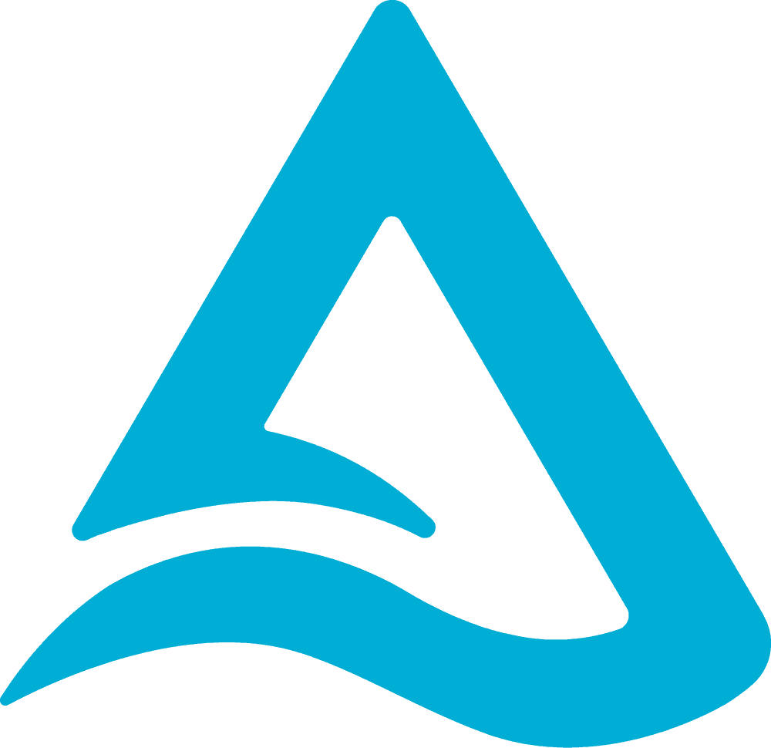
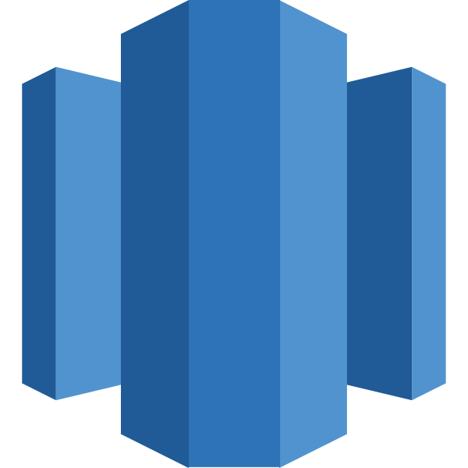
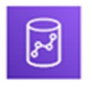
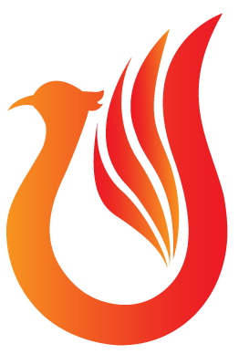







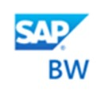






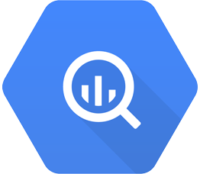
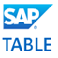






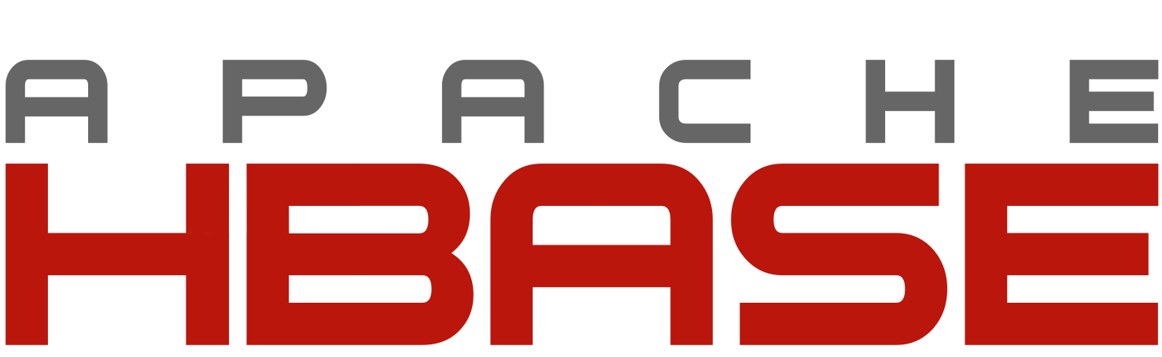

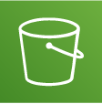

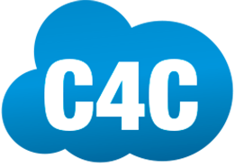




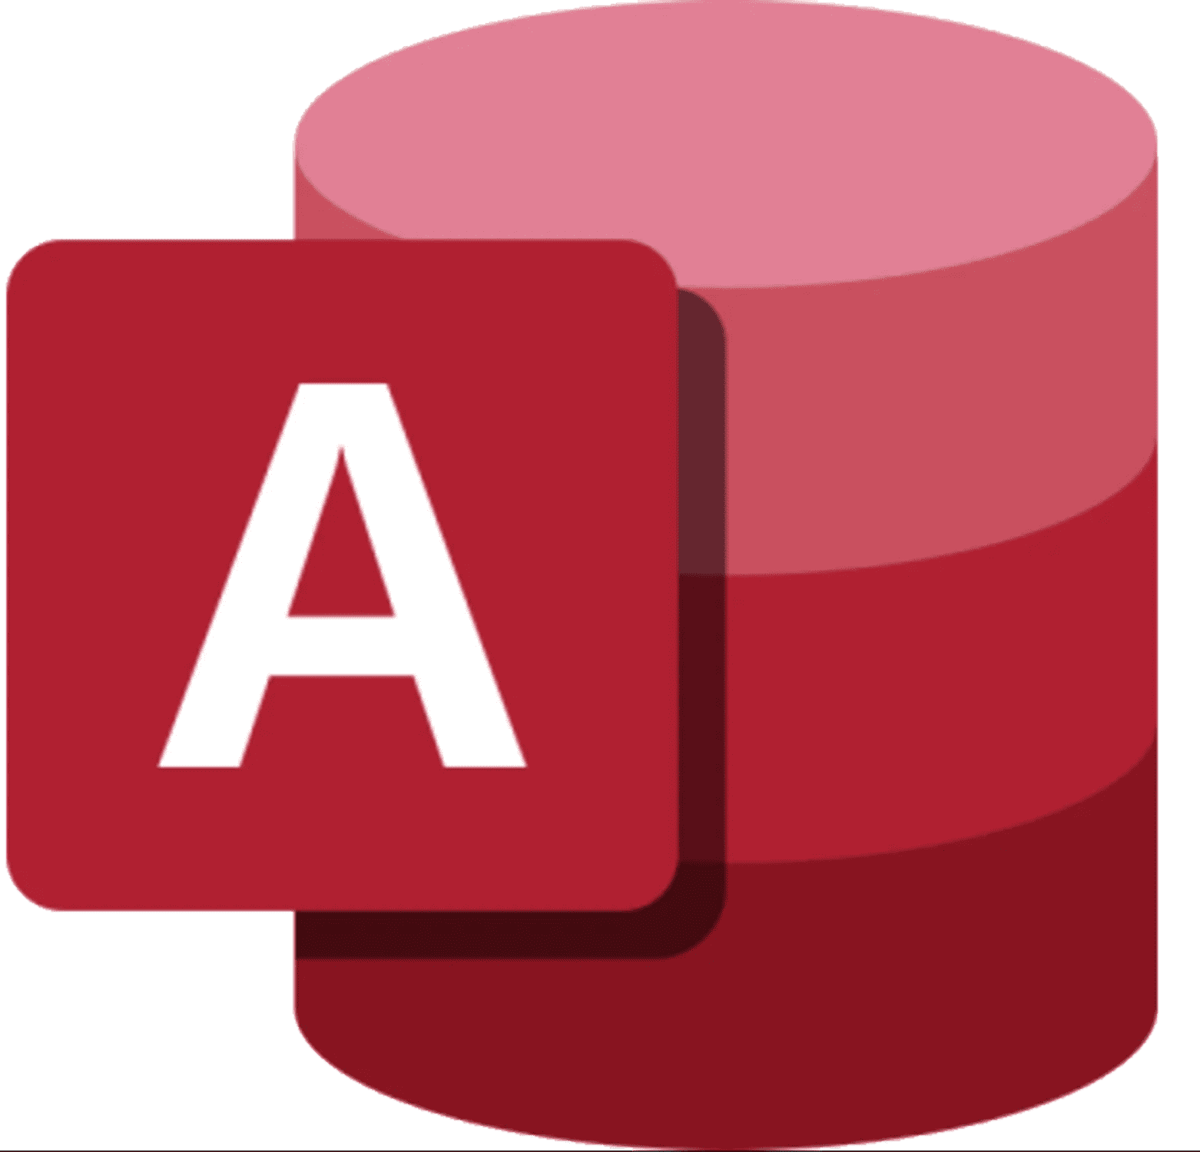
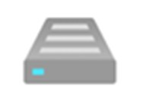
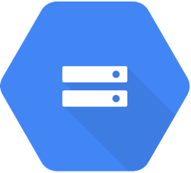

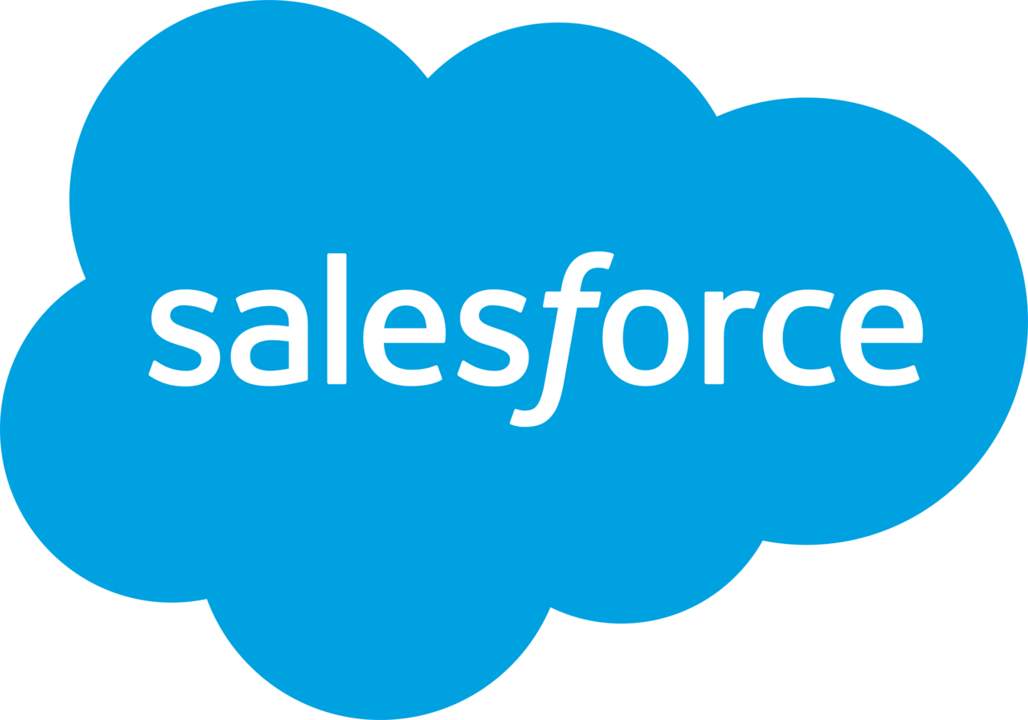

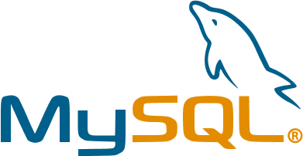
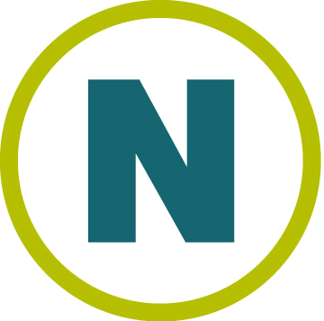




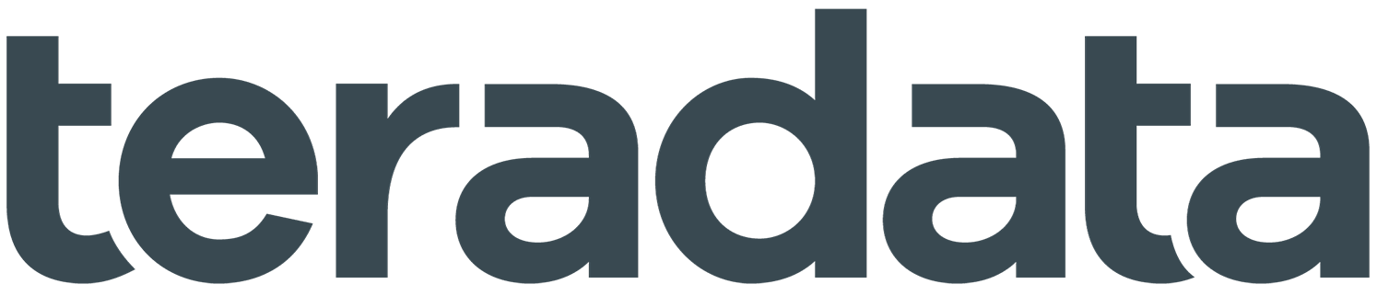



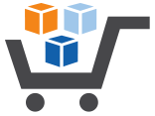

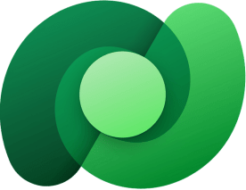


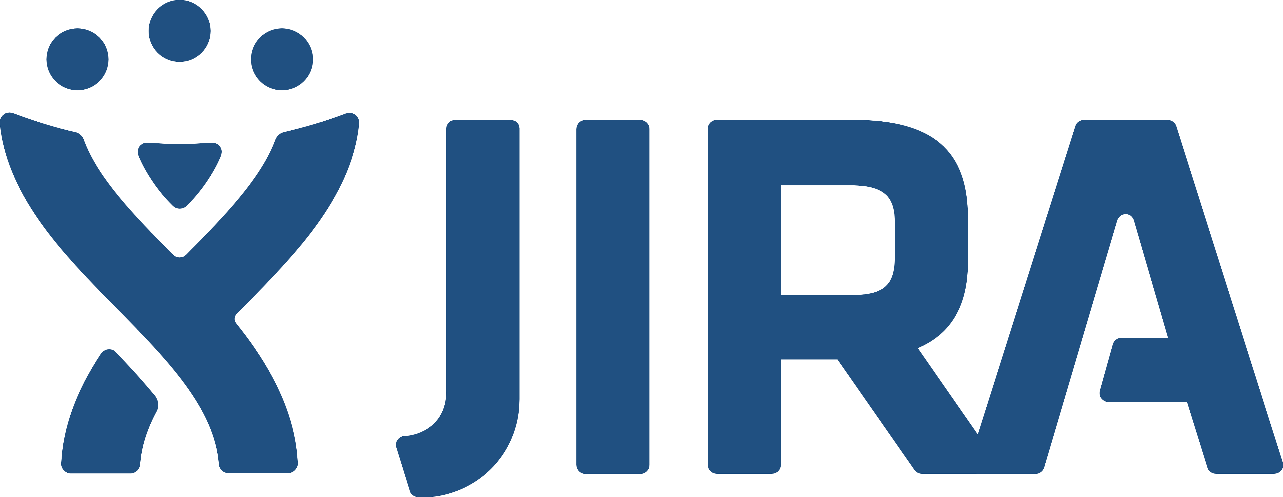
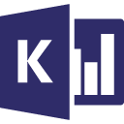
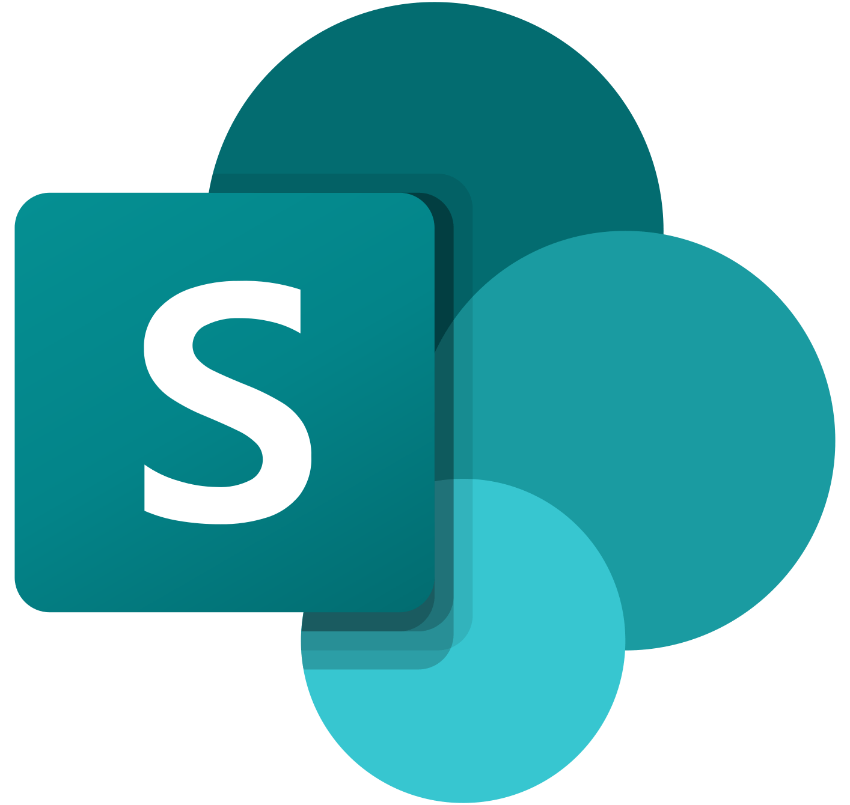
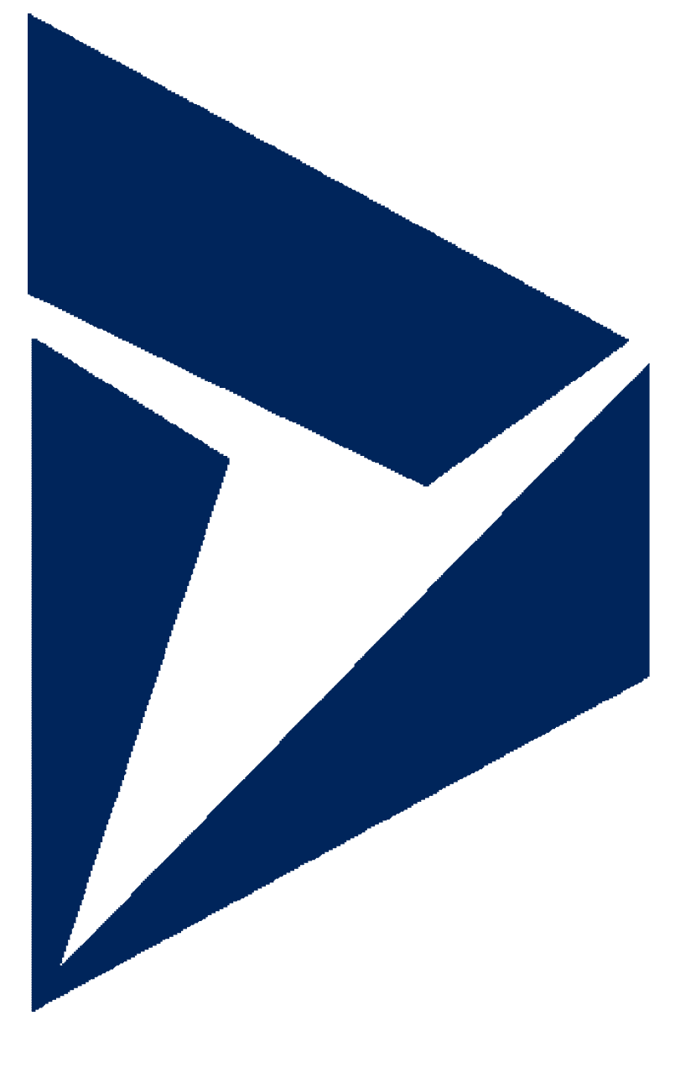
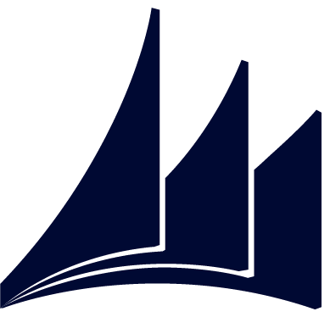

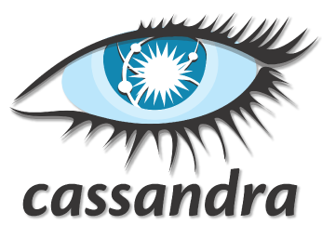

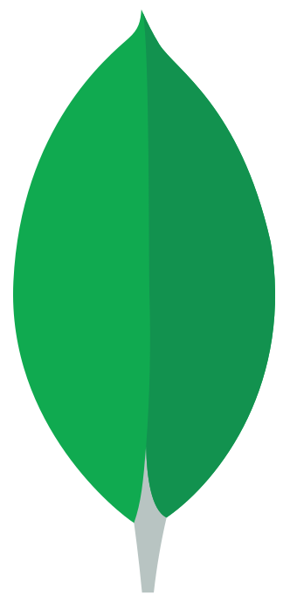
Unifying data in OneLake
Azure Database for PostgreSQL | Azure Databricks Delta Lake | Amazon RDS for Oracle | Amazon RDS for SQL Server | Amazon Redshift | Phoenix | PostgreSQL | Presto | Magento (Preview)
Azure SQL Database | Azure SQL Database Managed Instance | Apache Impala | Azure SQL Database Managed Instance | DB2 | SAP BW Open Hub | SAP BW via MDX | SAP HANA | Oracle Eloqua (Preview)
Azure Table Storage | MongoDB Atlas | Drill | Google AdWords | Google BigQuery | SAP Table | SQL server | Spark | PayPal (Preview)
Azure Cosmos DB (MongoDB API) | Azure Cosmos DB (SQLAPI) | Greenplum | HBase | Hive | Amazon S3 | Amazon S3 Compatible | FTP | SAP Cloud For Customer
Azure Data Lake Storage Gen1 | Azure Data Lake Storage Gen1 for Cosmos Structured Stream | Informix | MariaDB | Microsoft Access | File system | Google Cloud Storage (S3APD) | HDFS | Salesforce Marketing Cloud
Azure Data Lake Storage Gen1 for Cosmos Structured Stream | Azure Database for MariaDB | MySQL | Netezza | Oracle | HTTP | Oracle Cloud Storage (S3AP) | SFTP | Shopify (Preview)
Teradata | Vertica | ODBC | OData | REST | Amazon Marketplace Web Service | Concur (Preview) | Dataverse (Common Data Service for App) | Web Table
Jira | Kusto | SharePoint Online List | Dynamics 365 | Dynamics AX | Dynamics CRM | Cassandra | Couchbase (Preview) | MongoDB
Seamlessly connect to more than 170+ data stores
Data Factory
Notes:
Now we are announcing Dataverse shortcuts, work with all your dynamics data in OneLake, no data movement necessary

Slide 26






Shortcuts virtualize data across domains and clouds
No data movements or duplication
A shortcut is a symbolic link which points from one data location to another.
Data
Factory
Data
Engineering
Data
Science
Data Warehouse
Real-Time Intelligence
Power BI
Create a shortcut to make data from a warehouse part of your lakehouse.
Unified Security and Governance
Create a shortcut within Fabric to consolidate data across items or workspaces without changing the ownership of the data. Data can be reused multiple times without data duplication.
OneLake
Finance
Customer 360
Service telemetry
Business
KPIs
Warehouse
Lakehouse
Lakehouse
Warehouse
Existing ADLS Gen2 storage accounts and Amazon S3 buckets can be managed externally to Fabric and Microsoft while still being virtualized into OneLake with shortcuts.
Workspace A
Workspace B
All data is mapped to a unified namespace and can be accessed using the same APIs including the ADLS Gen2 DFS APIs.
Azure
Amazon
Dataverse
Google
Amazon S3 Compatible
On-Premises sources
Notes:
It is shortcuts that provide the connections between domains and clouds so that data can be virtualized into a single data product without data movement, data duplication or changing the ownership of the data. A shortcut is nothing more than a symbolic link which points from one data location to another. Just like you can create shortcuts in Windows or Linux, the data will appear in the shortcut location as if it were physically there.
Many of you already have existing data lakes stored in ADLS gen2 or in Amazon S3 buckets. With multi-cloud shortcuts, these lakes can continue to exist and be managed externally to Fabric. All data is mapped to a unified namespace and can be accessed using the same APIs including the ADLS Gen2 DFS APIs.

Slide 27
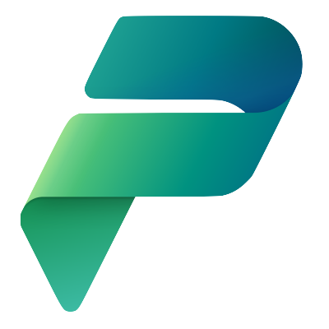

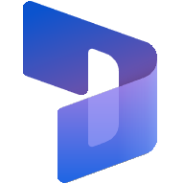
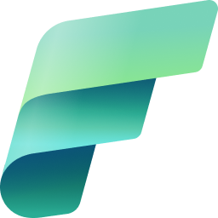
Dataverse makes it easy to connect Power Platform and Dynamics 365 to Fabric
No Copy. No ETL.
Direct Connection via Dataverse
Insights democratized to all low code apps and business using Fabrics 7 core workloads
Makers informed by insights improves quality of applications
Data is governed
Microsoft Power Platform
Microsoft Dataverse
Microsoft
Dynamics 365
Microsoft Fabric
Notes:
With a few clicks you can choose data and launch directly in Fabric
There is no data copy or ETL schedules to manage – the system does all the work for configuration and data movement
The system generates an Azure lakehouse, SQL endpoint and default semantic model with your data, saving hours and days of work.
Insights democratized to all low-code apps using core Fabric workloads
Open and governed access controls so data is protected

Slide 28
Data Engineering

Slide 29
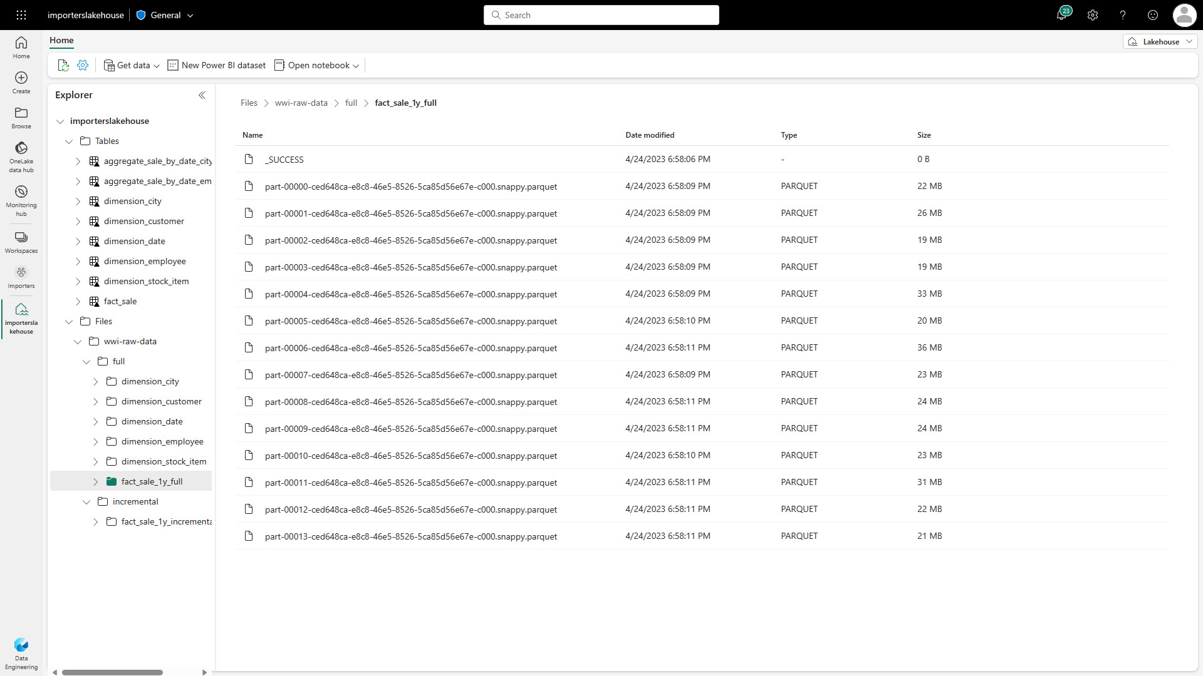
Lakehouse | Overview
Store, manage and analyze all your data in a single location & easily share across the entire enterprise
Quickly and easily create a Lakehouse without having to provision and configure compute, storage and networking
Key Capabilities:
Flexible and scalable solution that enables organizations to handle large data volumes of all types and sizes
Built-in SQL endpoint unlocks data warehouse capabilities on top of your Lakehouse with no data movement
Use ‘direct lake’ mode to build reports in seconds directly on top of the data lake with blazing fast performance
Easily ingest data into the Lakehouse through a variety of methods
Share your Lakehouse as a data product with consumers

Slide 30
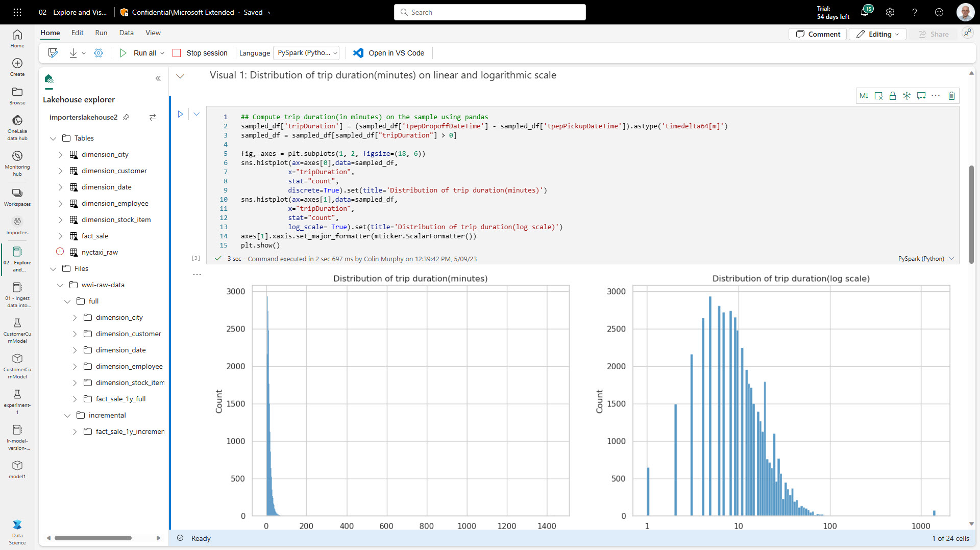
Lakehouse | Overview
Immersive authoring experience for data developers
Rich notebook capabilities including native Lakehouse integration, real-time collaboration with commenting support, auto-save support, lightweight scheduling and pipeline integration
Immersive authoring experience for data developers
Rich notebook capabilities including native Lakehouse integration, real-time collaboration with commenting support, auto-save support, lightweight scheduling and pipeline integration
Key Capabilities:
Manage your Python and R libraries through in-line installs using commands like %pip install
Advanced notebook development support with ability to reference notebooks in notebooks, and snapshots for easy troubleshooting
In context monitoring complete with real time advice and error analysis
Streamline data prep without giving up the power of reproducibility of Python
Key Capabilities:
Manage your Python and R libraries through in-line installs using commands like %pip install
Advanced notebook development support with ability to reference notebooks in notebooks, and snapshots for easy troubleshooting
In context monitoring complete with real time advice and error analysis
Streamline data prep without giving up the power of reproducibility of Python

Slide 31
Data Warehouse

Slide 32
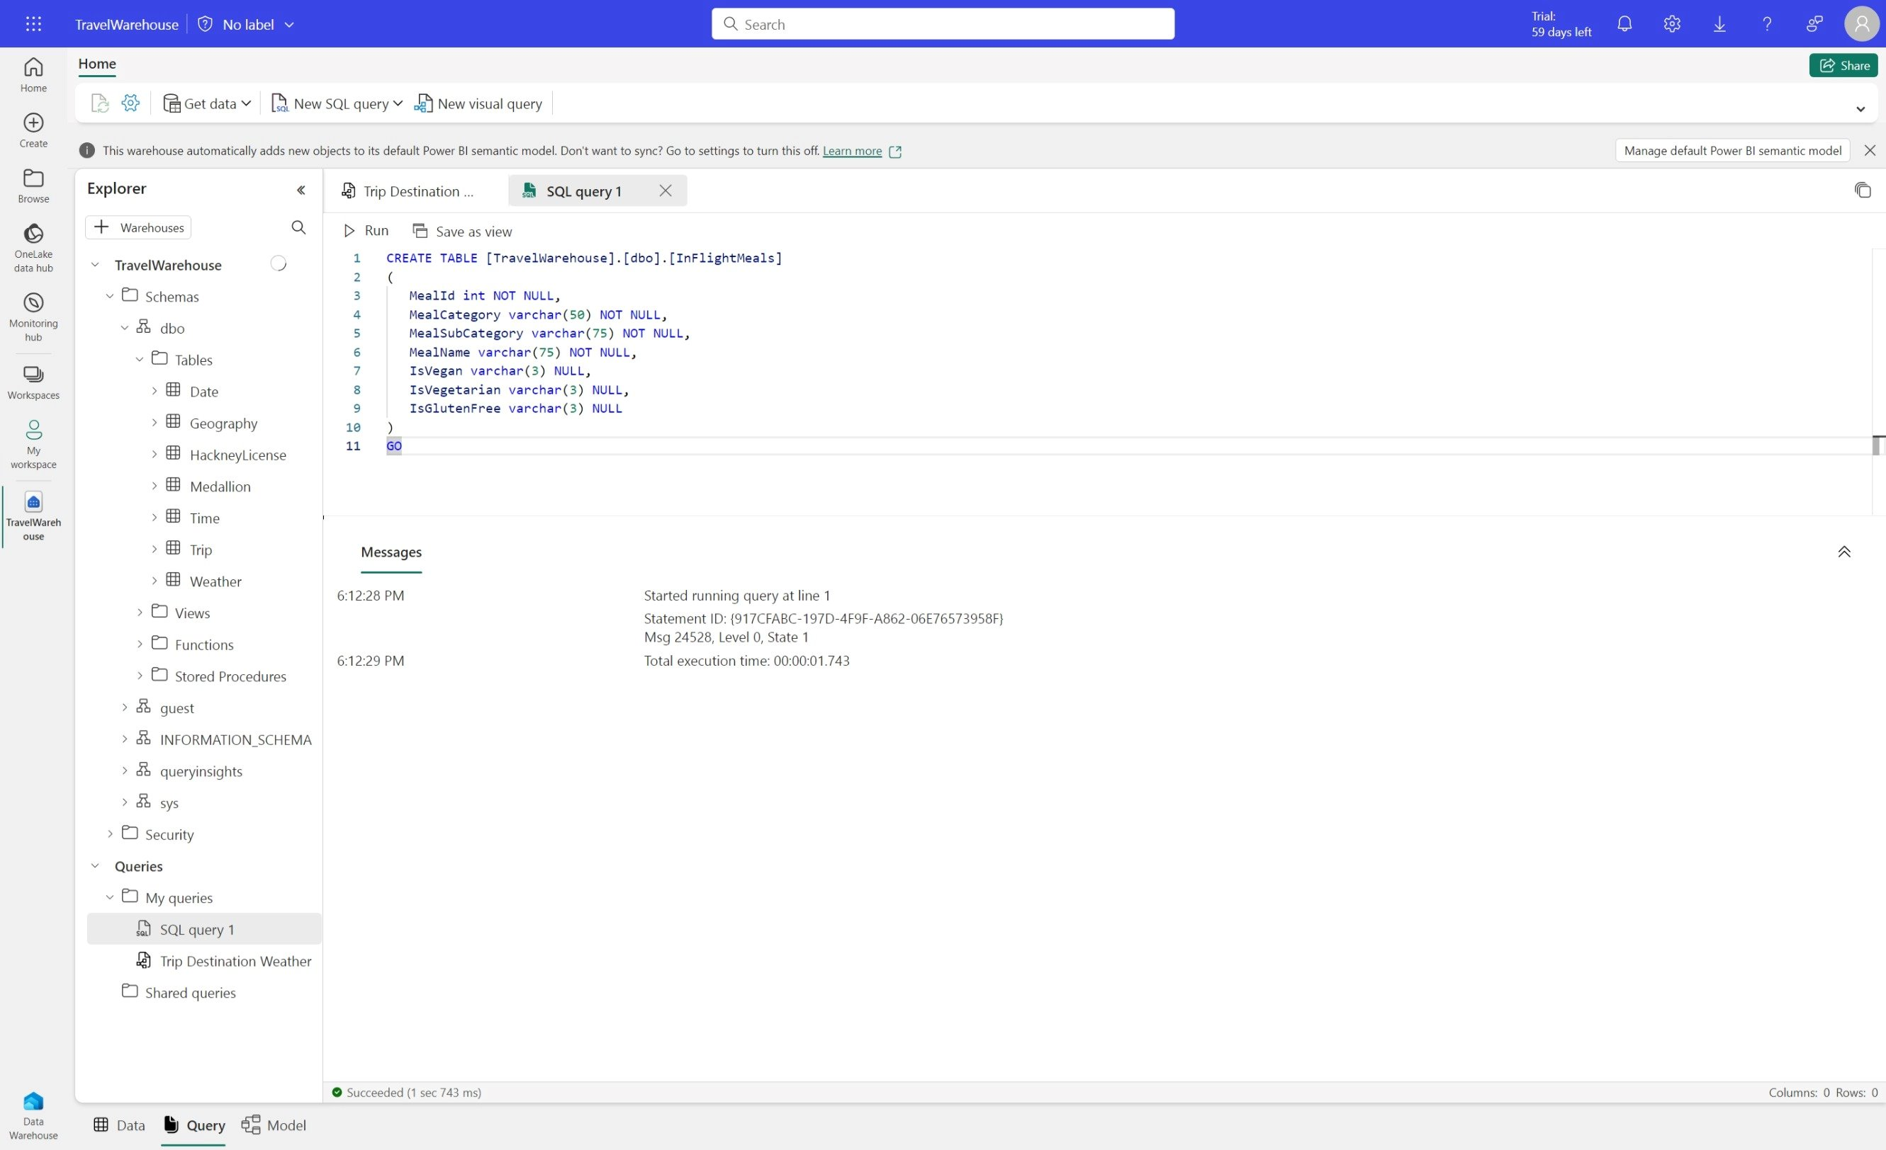
Data Warehouse | Overview
Enterprise scale data warehouse with open standard format
No knobs performance with minimal set-up and deployment, no configuration of compute or storage needed
Key Capabilities:
Lake-centric warehouse stores data in OneLake in open Delta format with easy data recovery and management
Use Fabric Mirroring for Zero-ETL integration of data from Azure SQL, Snowflake, or Azure Cosmos DB
Data loading and transforms at scale, with full multi-table transactional guarantees provided by the SQL engine
Virtual warehouses with cross-database querying and a fully integrated semantic layer
Flexibility to build data warehouse or data mesh based on organizational needs and choice of no-code, low-code, or T-SQL for transformations
Notes:
Other talking points:
Simple and intuitive warehouse experiences for both beginner and experienced data professionals
Fully integrated with all Fabric workloads out-of-the box
Enterprise-ready platform with end-to-end performance and usage visibility, with built-in governance and security
Microsoft Fabric's Data Warehouse offers a SaaS-like experience that combines the power of data lakes and warehouses, streamlining analytics investments. It provides a virtual warehouse capability for cross-database querying, which means data can be accessed from multiple sources without duplication, leveraging shortcuts for seamless integration​​.
The autonomous workload management ensures optimal performance without manual tuning, using an advanced distributed query processing engine that naturally isolates workloads. This separation safeguards against ETL jobs impacting ad-hoc analytics​​.
The Warehouse maintains data in an open parquet file format with Delta Lake Logs, allowing for ACID transactions and compatibility across different compute engines. This empowers data professionals to work collaboratively using their preferred tools on the same semantic model, enhancing efficiency and reducing redundancy​​.
The architecture separates storage and compute, affording instant scalability. It supports robust security measures and full ACID transactional guarantees, enabling multiple compute engines to read from any supported storage source​​.
Ingestion, loading, and data transformation at scale are facilitated by pipelines, dataflows, and cross-database querying. This integration with BI tools accelerates the time-to-insights for business users

Slide 33
Visual Query Editor
Key Capabilities:
Easy and efficient method to transform data
No-code experience
Interface like Power Query
No data duplication
Query executed on every call
Direct Lake not available

Slide 34
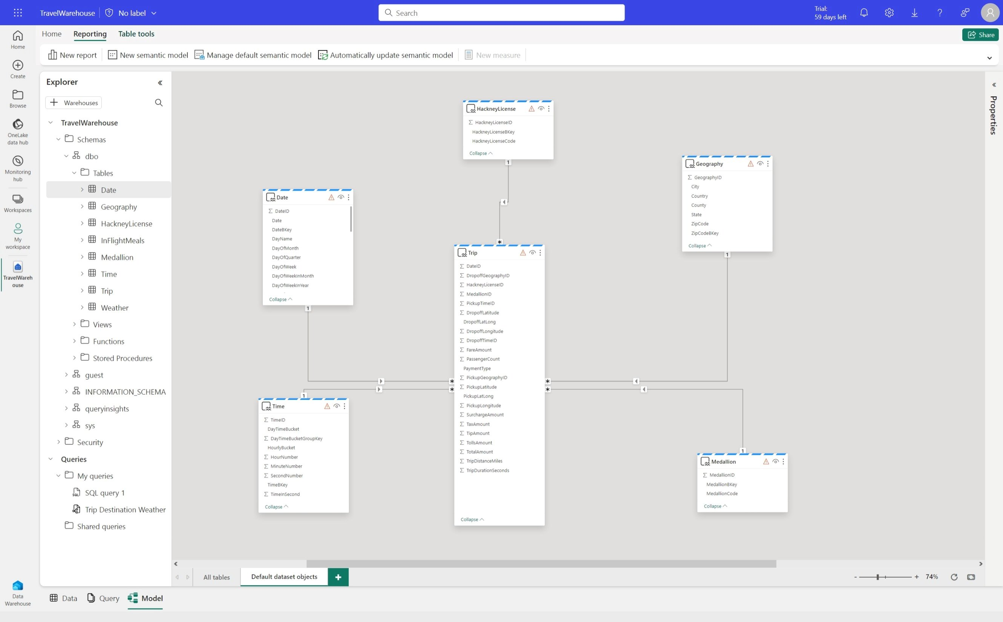
Fully integrated Power BI semantic layer
Reduce integration and gain insight from your data in seconds
Built-in Power BI enables everyone to visualize their data in seconds.
Key Capabilities:
Auto-generated semantic models always in sync
Default dataset in Direct Lake mode but automatically switches to Direct Query or Import mode as security or performance needs change
Flexibility to add/remove tables to dataset
Full web authoring experience for creating measures
Notes:
Talk about how autogenerated, flexibility to add/remove tables in semantic model

Slide 35
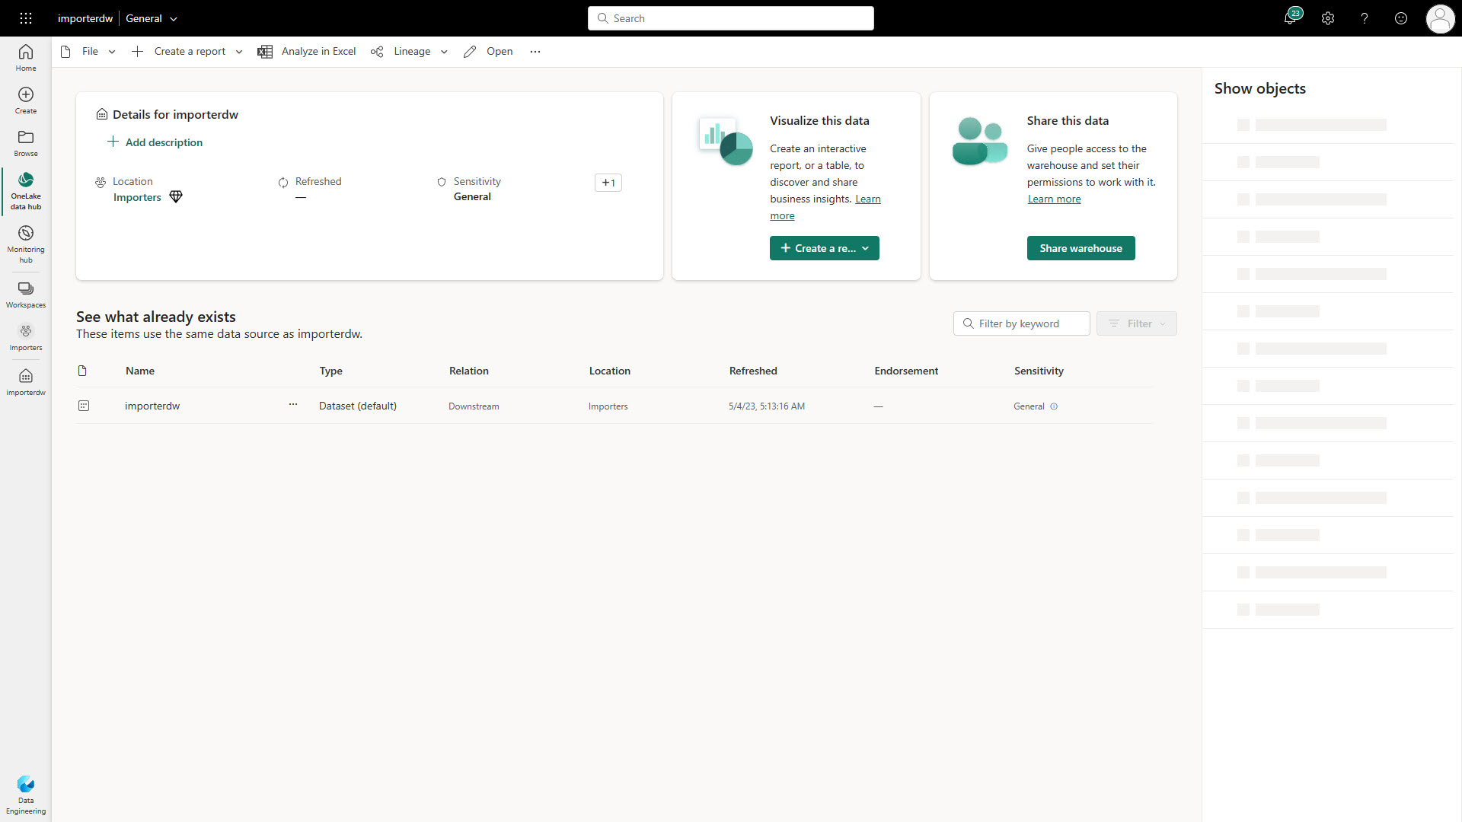
Secure by default
Keep data secure for any role accessing it and ensure peace of mind
Customers can secure their data using familiar constructs and ensure data is only visible to those authorized to do so
Key Capabilities:
Workspace roles: Workspace roles are used for collaboration with team. Add users to workspace with role assignment of Admin, Member, Contributor, Viewer
Artifact permissions: Artifact permissions are used for sharing for consumption of Warehouses. Provide access and share individual Warehouses with specific permissions
Data security: Use T-SQL, GRANT, REVOKE or DENY to secure any object within Warehouse. Users can be assigned to built-in custom roles.
Sensitivity labels: Apply sensitivity labels on your Warehouse to classify sensitive data.
Granular security: Implement row or column security or Dynamic Data Masking for granular data access control
Notes:
Microsoft Fabric integrates its permissions with granular SQL permissions to control access to the Warehouse, ensuring secure connectivity and precise user permission management once connected​​.
Workspace roles enable collaboration within a workspace, and item permissions allow for direct assignment to individual Warehouses, facilitating sharing for downstream consumption​​.
Object-level, row-level, and column-level security measures are implemented for detailed access control, alongside dynamic data masking to protect sensitive data without altering application queries​​.
Warehouses can be shared conveniently within an organization, with customizable permission levels for downstream users consuming the Warehouse using SQL, Spark, or Power BI

Slide 36




Mirroring in Microsoft Fabric
Simplify near real-time intelligence
Fabric compute engines
Fabric Mirroring enables adding existing databases and data warehouses to Fabric without any ETL.
Microsoft Fabric
A full editing experience of the source database is available for the Mirrored database.
Data
Factory
Data
Engineering
Data
Science
Data Warehousing
Real-Time Intelligence
Power BI
Partner & Industry workloads
Spark
T-SQL
Serverless Compute
KQL
Analysis Services
Data is replicated into OneLake in Delta format and kept up-to-date in near-real-time.
All the Fabric experiences instantly work with the OneLake replica.
Customer 360
Finance
Service Telemetry
Business KPIs
OneLake
Analysts and Data Scientists can work with real-time data.
The replica protects operational databases from analytical queries.
Azure COSMOS DB
Azure SQL DB
Mongo
DB
Snowflake and more…
Mirroring
Notes:
Why use Mirroring in Fabric?
Today many organizations have mission critical operational or analytical data sitting in silos.
Accessing and working with this data today requires complex ETL (Extract Transform Load) pipelines, business processes, and decision silos, creating:
Restricted and limited access to important, ever changing, data
Friction between people, process, and technology
Long wait times to create data pipelines and processes to critically important data
No freedom to use the tools you need to analyze and share insights comfortably
Lack of a proper foundation for folks to share and collaborate on data
No common, open data formats for all analytical scenarios - BI, AI, Integration, Engineering, and even Apps
Mirroring in Fabric provides an easy experience to speed the time-to-value for insights and decisions, and to break down data silos between technology solutions:
Near real time replication of data into a SaaS data-lake, with built-in analytics built-in for BI and AI

Slide 37

Thank You!!
Contact:
Email: russ.seaman@tdsynnex.com
LinkedIn: www.linkedin.com/in/russseaman
Notes:
With a few clicks you can choose data and launch directly in Fabric
There is no data copy or ETL schedules to manage – the system does all the work for configuration and data movement
The system generates an Azure lakehouse, SQL endpoint and default semantic model with your data, saving hours and days of work.
Insights democratized to all low-code apps using core Fabric workloads
Open and governed access controls so data is protected

Slide 38

Notes:
With a few clicks you can choose data and launch directly in Fabric
There is no data copy or ETL schedules to manage – the system does all the work for configuration and data movement
The system generates an Azure lakehouse, SQL endpoint and default semantic model with your data, saving hours and days of work.
Insights democratized to all low-code apps using core Fabric workloads
Open and governed access controls so data is protected

